Slide 1

ANKARA YILDIRIM BEYAZIT UNIVERSITY GRADUATE SCHOOL OF NATURAL AND APPLIED SCIENCES COMPUTER ENGINEERING DEPARTMENT
A Simulation of Armed Unmanned Aerial Vehicles Swarm

Slide 2
By Cemil Uysal (16050111006) Levent Gümrükçü (16050111029) Berkay Kırtıllı (1605011037) Bilal Emre Karagöz (16050111039) Supervised by Tarık Ismet Alkan

Slide 3

Introduction

Slide 4

Researches About Project

Slide 5

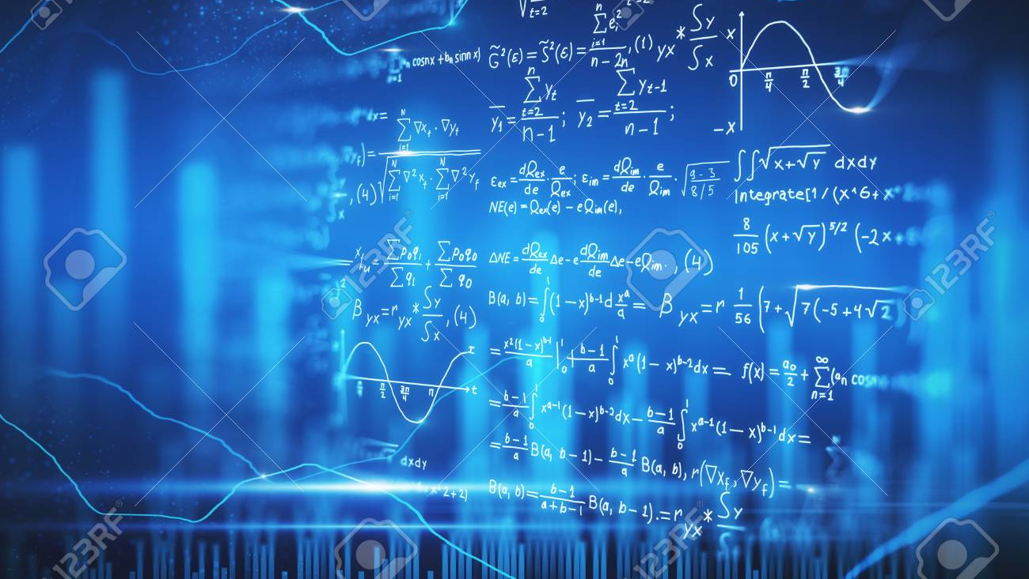
Complex Systems
Nonlinearity
Network
Emergence
Adaptation

Slide 6
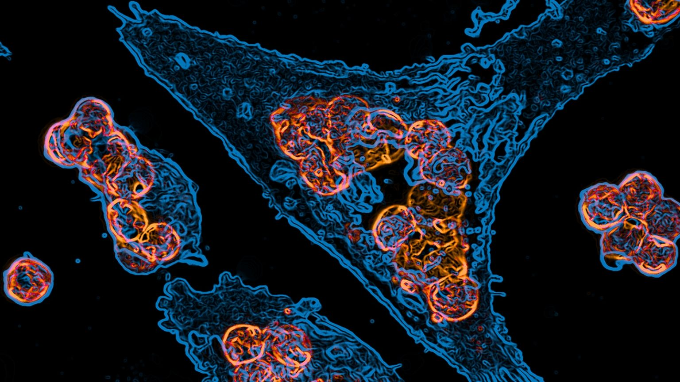
Agent-Based Systems
History
Theory
Applications
Implementation
Verification and Validation

Slide 7

Multi-Agent Systems
What are Multi-Agent Systems (MAS)
Application Field
Advantages of Multi-Agent Systems
Architecture

Slide 8
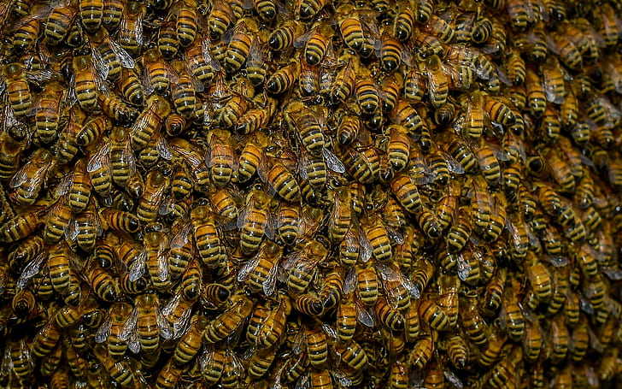
Swarm as Cognitive Entity
Conceptual Framework for Decision Making
The Sensory Transformation in a Swarm
The Decision Transformation in a Swarm
The Action Transformation in a Swarm

Slide 9
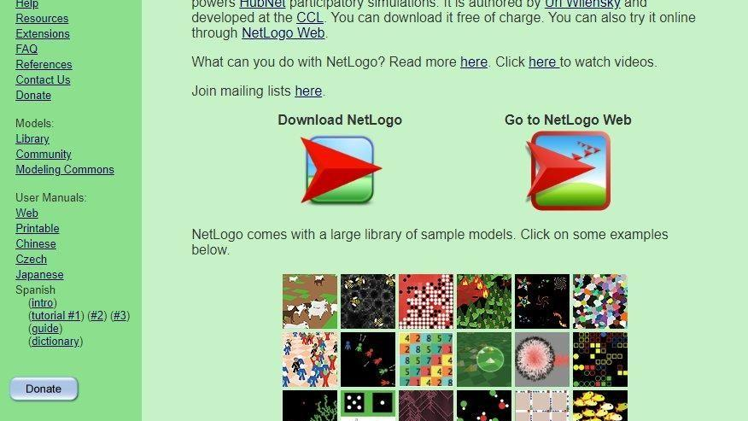
NetLogo
Usage and Features of NetLogo
Functional Requirements on NetLogo for Project

Slide 10
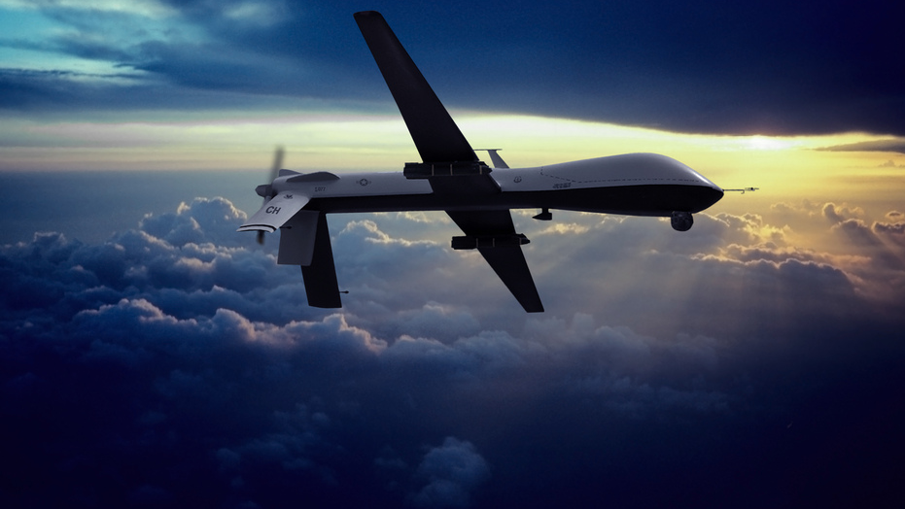
Features of UAV’s

Slide 11
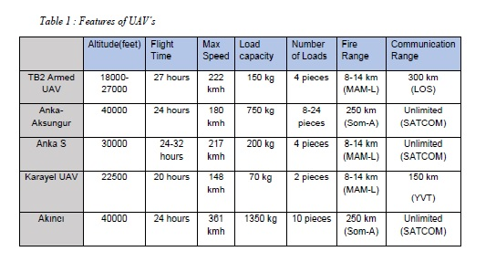

Slide 12
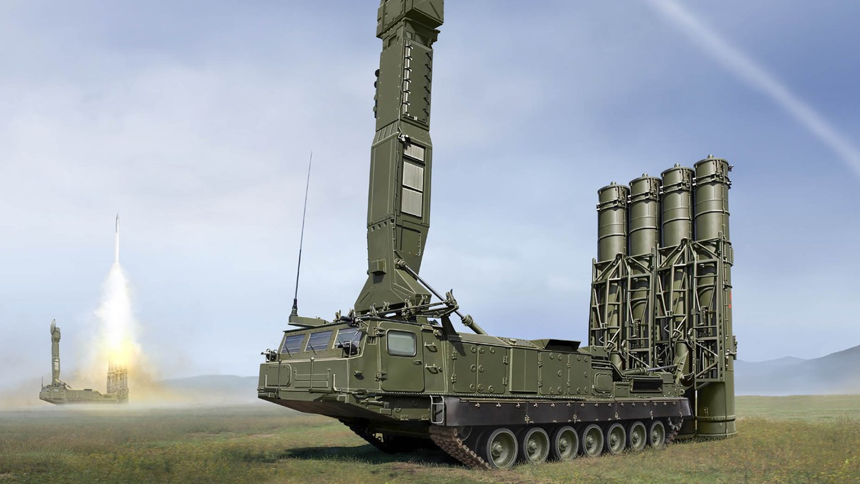
Features of Air Defense Systems

Slide 13
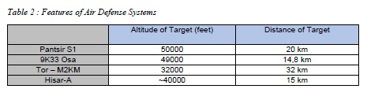

Slide 15

Code Design
Class Diagram
Creating Environment Codes in NetLogo

Slide 16

Result

Slide 17

Interface

Slide 18
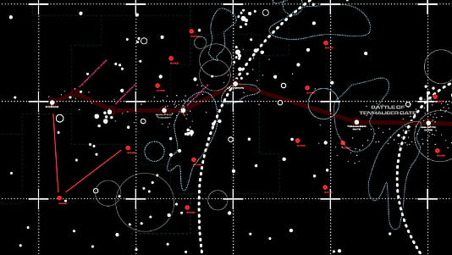
Simulation

Slide 19

Thank You

